Slide 1



Course: Image Processing 31651 Assignment #23 Pixel to Pixel Operations (Part 3)
Photo of the student | Shorten Name | ID (4 last digits)
 | shienfeld | 1950 | Student #1
 | pony | 2210 | Student #2
 | akimov | 7939 | Student #3
Photo of the student | Shorten Name | ID (4 last digits)
 | shienfeld | 1950 | Student #1
 | pony | 2210 | Student #2
 | akimov | 7939 | Student #3

Slide 2
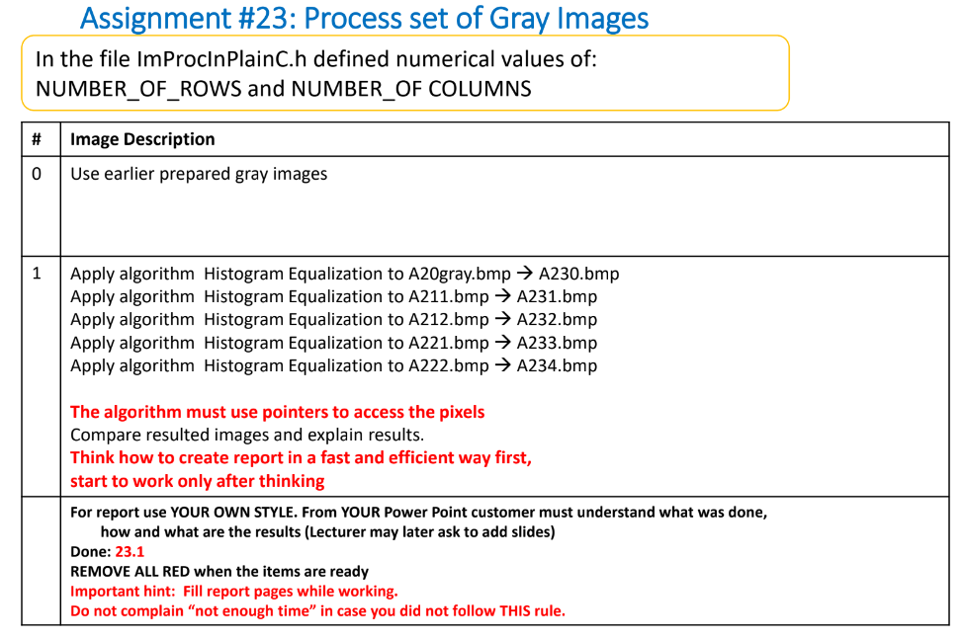

Slide 3

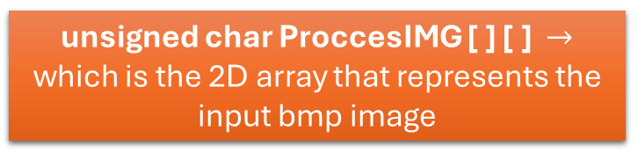

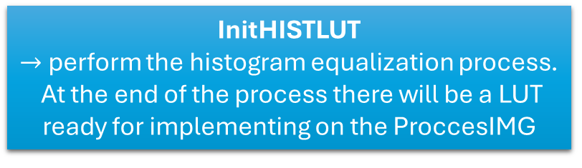
23.0 - flow chart of the code – general look
Gray image in bmp format a gray image created in Assignments #21 & #22 – saved in bmp format
LoadGrayImageFromGrayBmpFile
Create a histogram and calculate the Cumulative Histogram (Integral Histogram) of the GrayImage [ ] [ ]
unsigned char ProccesIMG [ ] [ ] $→$ which is the 2D array that represents the input bmp image
InitHISTLUT
$→$ perform the histogram equalization process.
At the end of the process there will be a LUT ready for implementing on the ProccesIMG
ApplyLUTonGrayImage
$→$ a function that applies the created LUT on the ProccesIMG
StoreGrayImageAsGrayBmpFile $→$Store the new GrayImage as a bmp file (after transformation using LUT)

Slide 4
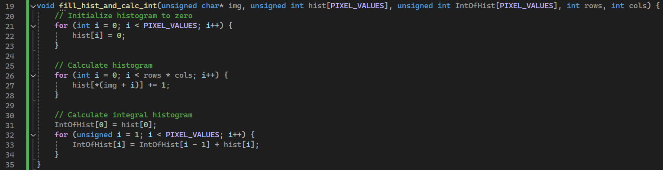
23.1 – first important function – fill_hist_and_calc_int
The histogram array is initialized to zero to ensure accurate frequency counts of pixel values.
Iterate through each pixel in the image using pointer arithmetic to count the frequency of each pixel intensity.
Compute the cumulative distribution of pixel intensities by summing the histogram values.
The Purpose of the fill_hist_and_calc_int function is To calculate the histogram and integral histogram of a grayscale image, which are essential for the histogram equalization.
For that assignment only the integral of the histogram is really needed. In 23.2 we will present the creation process of the LUT using the integral of histogram – that process is the histogram equalization

Slide 5
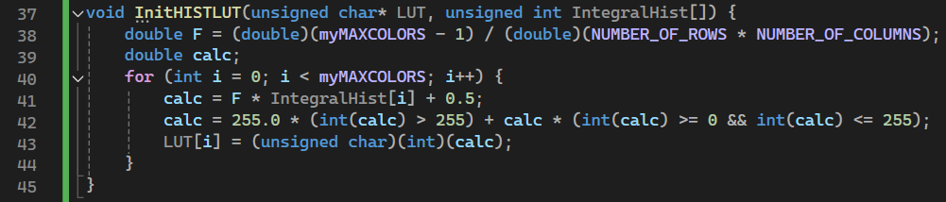
23.2 – second important function – InitHISTLUT
The Purpose of InitHISTLUT function is perform the histogram equalization process. The function takes as inputs the (already filled) integral of histogram (created before) and an empty array as LUT - it Iterate through each possible pixel intensity value and calculate the corresponding new intensity value using the integral histogram and the normalization factor.

Slide 6
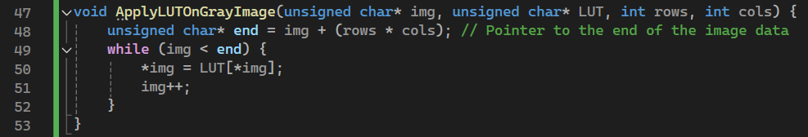
23.3 – third important function – ApplyLUTOnGrayImage
This function applies the previously created LUT to the image.
The purpose is to transform the original pixel values to new values based on the LUT for histogram equalization.

Slide 7
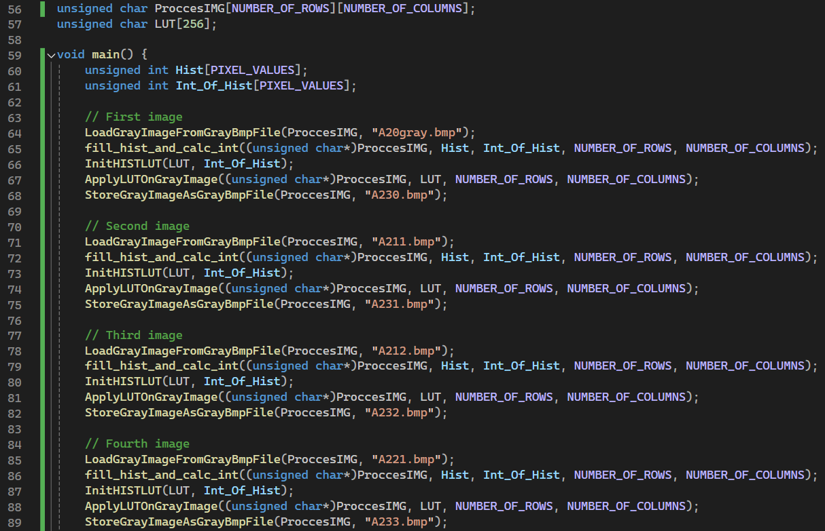
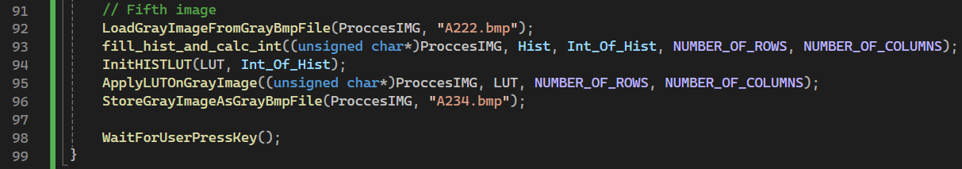
23.4 – fourth important function – the “main” function

Slide 8
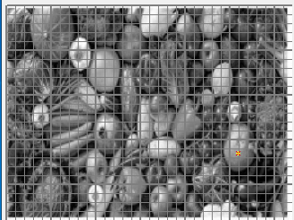
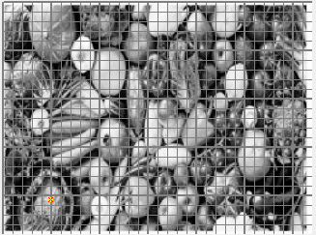
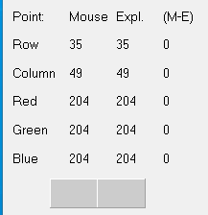
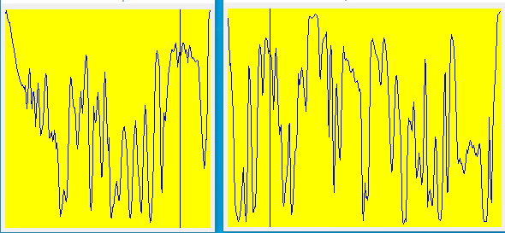
23.5 – demonstration using profiler – part 1/5
A20gray.bmp
A230.bmp
After process
We can see that after activating the "Histogram Equalization" the image changed slightly in that it came out a little darker and sharper.

Slide 9
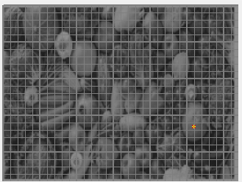
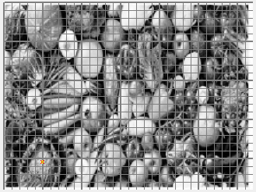
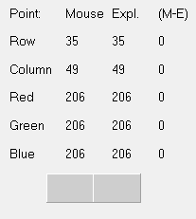
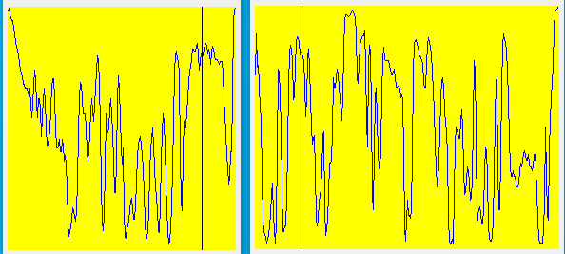
23.5 – demonstration using profiler – part 2/5
A211.bmp
A231.bmp
After process
Here we can see that the algorithm worked very well on the image. The ruined image has been corrected very well to the point of clear and sharp colors (relative to the ruined image).

Slide 10
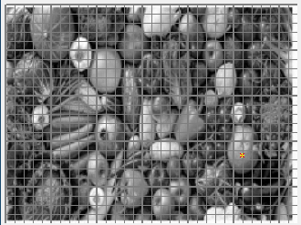
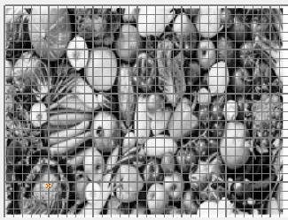
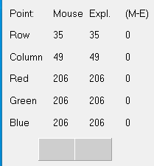
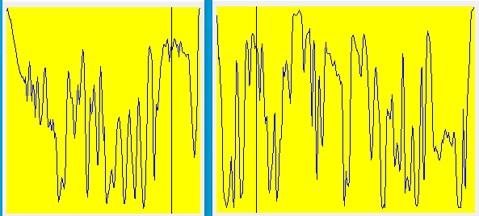
23.5 – demonstration using profiler – part 3/5
A212.bmp
A231.bmp
After process
Because the image on which the algorithm was performed is very similar in color to the image “A20gray.bmp” we see that the algorithm worked in a very similar way and there are almost the same results.

Slide 11
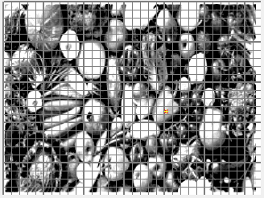
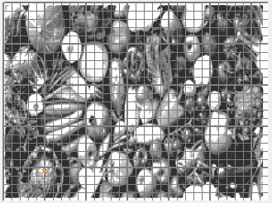
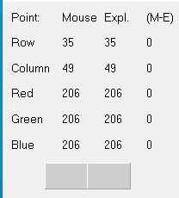
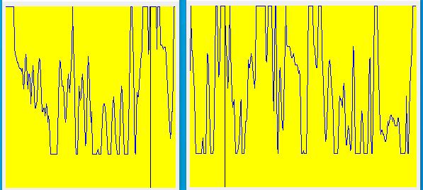
23.5 – demonstration using profiler – part 4/5
A221.bmp
A233.bmp
After process
The algorithm failed to correct this image in a good way. The result is that the image produced becomes darker.

Slide 12
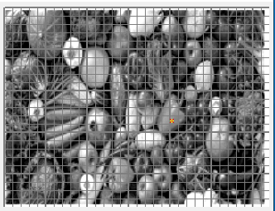
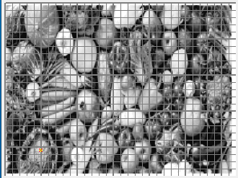
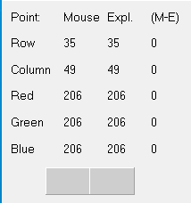
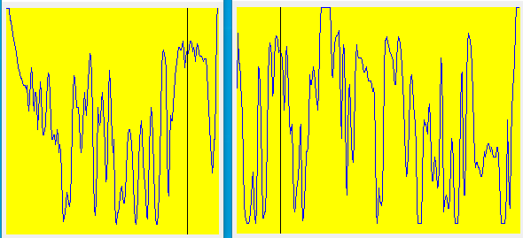
23.5 – demonstration using profiler – part 5/5
A234.bmp
After process
Here too, the algorithm failed to correct well enough. The image become lighter and less “authentic”.

Slide 13
23.6 –conclusions
On the ruined image (A211) the algorithm worked best and an improvement can be seen. On images with too high a contrast the image is slightly destroyed. Images that came out good were slightly destroyed. Overall conclusion: Low-contrast images, although more "ruined" than high-contrast images, the algorithm worked better.

Slide 14
23.7 What did we learned?
To use histogram equalization algorithm

